Slide 1


a
Hindu Institute of
Management
Web Browsers
Represented by: – Shubham Dahiya

Slide 2


a
What is Search Engine
It is basically a type of program that uses keywords to search for documents that relate to these keywords and then puts the results found in the order of relevance to the to the topic that was searched for.
Example:
Google
Yahoo
.

Slide 3
Importance of Search Engines
Search engines are important because with over 8 billion web pages availabel, it would be impossible to search for the information that is specifically needed. This is why search engines are used to filter the information that is on the internet and transform it into results that each individual can easily access and use within the matter of seconds

Slide 4

Types of Search Engines
Crawler based search engines
Directories
Specialty search engines
Hybrid Search Engines
Meta Search Engines

Slide 5
Crawler based Search Engines
Search Engines that use software program, are called “Spiders”. “Crawlers”, “Robots”, “Bots”. These program can access the webpages to categorize and analyze them and then add them in the search engine database, where any user can find them when searching. The crawler based search engines are constantly updated with new webpage that would be available in their database.
Example:
Google, Yahoo, Ask.com

Slide 6

Google
Google began n January 1996 as a research project.
Founded by Larry Page and Sergey Brin.
Most popular search engine.
Besides the man search-engine feature of searching of text. Google
Search has mac, than 22 "special features- like weather. unit conversion.
currency conversion, time, calculator, maps. and sports scores.

Slide 7
Yahoo
Yahoo! provides Internet communication services such as
Yahoo! Messenger and Yahoo! Mail.
Yahoo! Offers social networking services such as My Web, Yahoo! Personals, and Flickr.

Slide 8

Ask.com
A question and answer focused search engine.
Founded in 1998 by Garret Gruener and David Warhten in Berkley, California

Slide 9


Directories
Are websites sectioned in specific categories by human editors and are then placed in Directories database.
Example:
Yahoo Directory (www.Yahoo.com)
Open Directory (www.dmoz.org)

Slide 10

Specialty Search Engine
They help the user search in different areas in specific types of lists that are specialized in specific topic that would be beneficial for narrowing down the searching process.
Examples: Askjeeves (Question and answer search engine), Medhunt (Provides only medical information) .

Slide 11


Hybrid Search Engines
Example: Yahoo.com Google.com
Are search engines that use both crawler based searches and directory searches to obtain their results.

Slide 12
Meta Search Engines
Are search engines that combine all the results from other search engines into one big list.
Examples: Metacrawler Dogpile

Slide 13
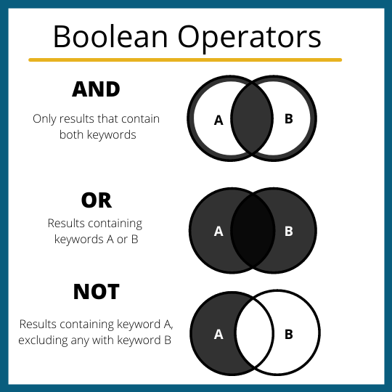
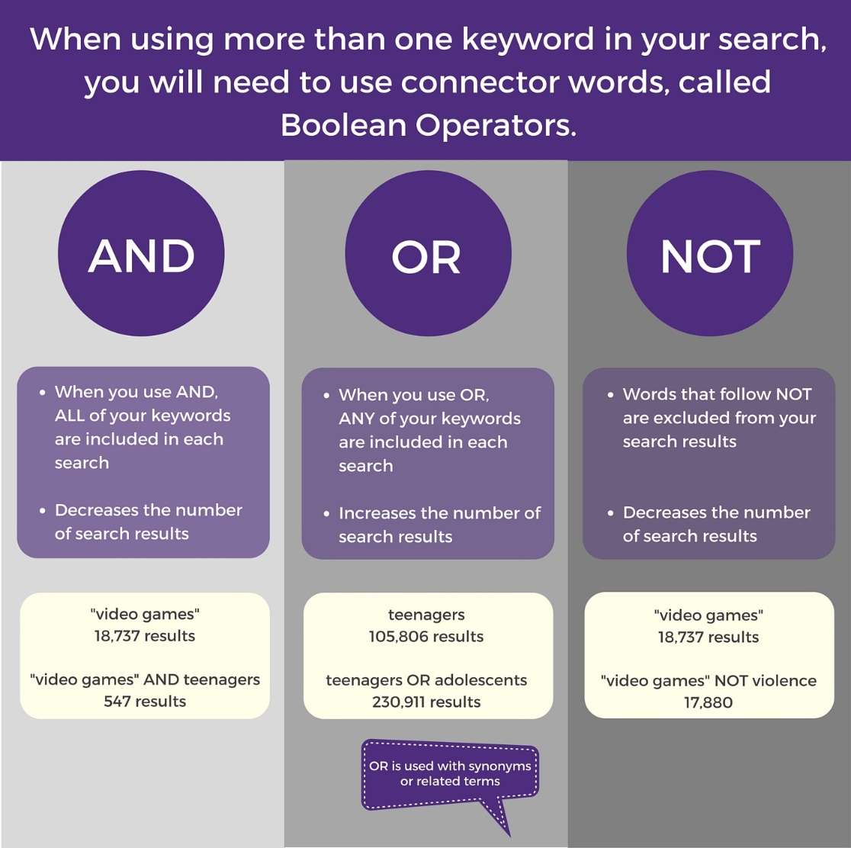
Boolean Searches
Boolean searches uses the “Boolean operators” (And, Or, Not and Near) to combine words and make the search topic more specific and limited for the user

Slide 14
Boolean Operator
And is equal to the + symbol.
Not is equal to the -- symbol.
OR means that the search engines automatically return to the words that you type in.
Near is equal to putting quotes for a specific phrase such as “Shakespeare sonnets”

